Slide 1
EU Research funding landscape and the share of Dutch unversities
Jurgen Rienks, director Neth-ER

Slide 2
What is / does Neth-ER?
Netherlands house for Education and Research
Association with 8 members, and 3 associate members

Slide 3
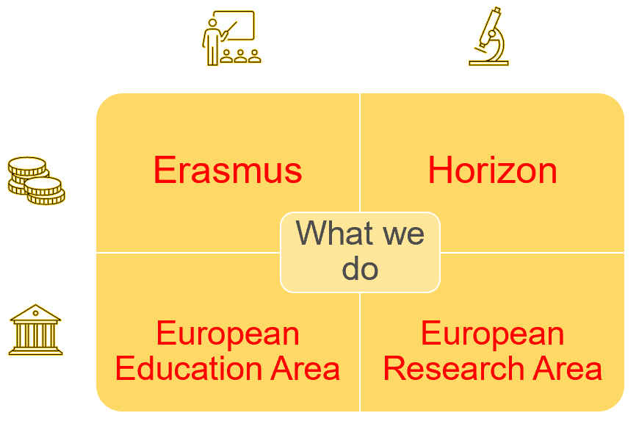
Neth-ER’s mission
To provide correct and topical information on European policy developments regarding knowledge-dossiers to serve the Dutch knowledge field.
To support the European positioning and the influence on European policies by its membership.
Specific attention is given to:
Erasmus(+) and EEA
Horizon (2020 / Europe) and ERA
European Structural and Investment Funds
Notes:
Verspreiden van relevante informatie (website, nieuwsbrief)
Organiseren van seminars en recepties
Onderhouden van relevant (inter)nationaal netwerk
Adviseren en ondersteunen van leden/achterban
Bieden van kantoorfaciliteiten, zoals werkplekken en vergaderruimten

Slide 4
On the political agenda
Horizon Europe almost established as a programme
Waiting for outcome of budget-negotiations => MFF 2021-2027
Need to prepare for stratgey and first calls
Geopolitical situation asks for reflection and action
USA and China
COVID-19 => Recov. and Resilience Fund (Next Gen EU)
Competitive position; Technological sovereignty
Sustainable Development Goals & Twin transition
Brexit
European Research Area
Where do we stand?

Slide 5
Multiannual Financial Framework
Strenuous negotiations over 2 years
Frugal countries, incl NL
Eur. Parliament fighting for Horizon and Erasmus
Covid-crisis resulting in Recovery and Resilience Fund (RRF).
Additional 750 Bln €
Politically linked with ‘rule of law’.
European Parliament
Hungary, Poland,
Without MFF no start of new programmes.
Expected outcome
=> Erasmus 23,4 Bln €
=> Horizon EU 84,9 Bln €

Slide 6
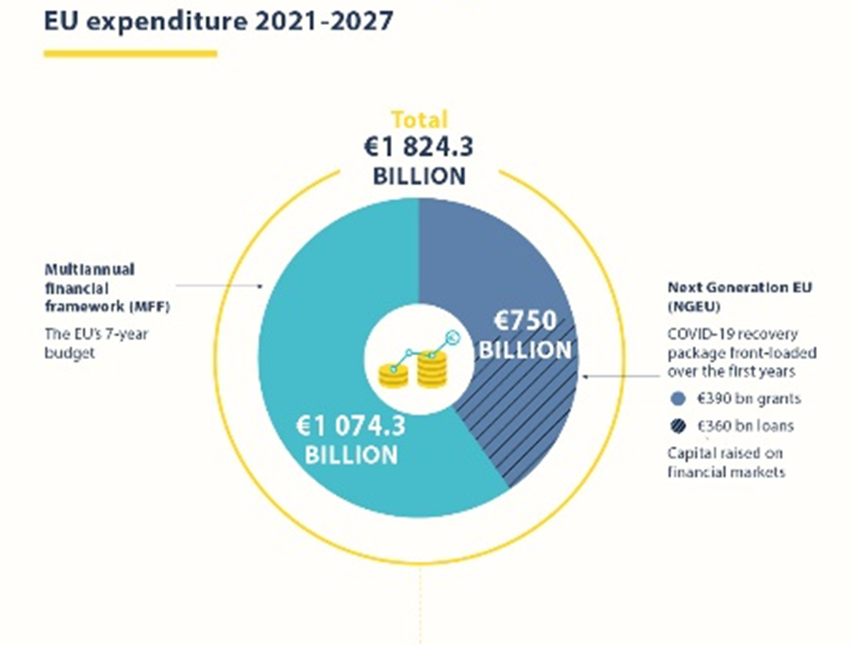
Multiannual Financial Framework
Strenuous negotiations over 2 years
Frugal countries, incl NL
Eur. Parliament fighting for Horizon and Erasmus
Covid-crisis resulting in Recovery and Resilience Fund (RRF / NGEU).
Additional 750 Bln €
Politically linked with ‘rule of law’.
European Parliament
Hungary, Poland,
Without MFF no start of new programmes.
Expected outcome
=> Erasmus 23,4 Bln €
=> Horizon EU 84,9 Bln €

Slide 7
Horizon Europe (as successor to Horizon 2020)

Slide 8
Horizon Europe
FP9 for research and innovation 2021-2027
Estimate of budget division by Neth-ER.
Budget total 79,9 Bln €
(4 Bln € still to be divided)
Budgetline is horizontal over 7 years, no inclination
Additional 5 Bln € NGEU, divided over 4 years
20,5
41,8
10,7
2,8

Slide 9
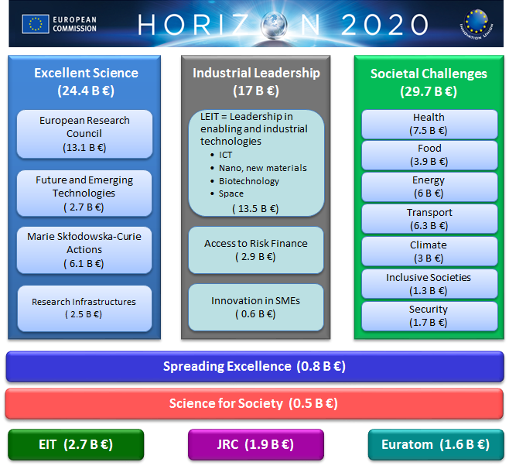
Horizon 2020
FP8 for Research and innovation
Horizon 2020: 2014-2020
Budget: 70,2 Billion Euro
Budget line is inclining over 7 years

Slide 10
Horizon 2020
State of play 17 June 2020
54,17 Bln € in contracted projects
Pillar 1 Excellent Science 20,70 Bln €
Pillar 2 Industr. Leadershio 11,05 Bln €
Pillar 3 Societal Challenges 19,89 Bln €

Slide 11
The Netherlands
State of play 17 June 2020
4,22 Bln € in contracted projects
About half of the Horizon funds goes to research universities and university medical centres.
Pillar 1 Excellent Science 1,78 Bln €
Pillar 2 Industr. Leadershio 0,70 Bln €
Pillar 3 Societal Challenges 1,65 Bln €

Slide 12
Erasmus University
State of play 17 June 2020
31,07 Mln €
69 funded projects
616 partnering organisations
49 collaborating countries
Pillar 1 Excellent Science 17,33 Mln €
Pillar 2 Industr. Leadershio 1,99 Mln €
Pillar 3 Societal Challenges 10,33 Mln €
Excellent Science: ERC 12,18 Mln €
Health, demographic change and wellbeing
4,98 Mln €
Europe in a changing world 1,79 Mln €
Notes:
#25 of

Slide 13
Tilburg University
State of play 17 June 2020
25,68 Mln €
39 funded projects
209 partnering organisations
31 collaborating countries
Pillar 1 Excellent Science 21,87 Mln €
Pillar 2 Industr. Leadershio 1,94 Mln €
Pillar 3 Societal Challenges 4,8 Mln €
Excellent Science: ERC 19,19 Mln €
Health, demographic change and wellbeing
0 Mln €
Europe in a changing world 0,63 Mln €
Notes:
#25 of

Slide 14
Maastricht University
State of play 17 June 2020
90,37 Mln €
176 funded projects
1320 partnering organisations
62 collaborating countries
Pillar 1 Excellent Science 54,38 Mln €
Pillar 2 Industr. Leadershio 6,87 Mln €
Pillar 3 Societal Challenges 26,94 Mln €
Excellent Science: ERC 25,61 Mln €
Health, demographic change and wellbeing
19,18 Mln €
Europe in a changing world 2,73 Mln €€
Notes:
#25 of

Slide 15
European Research Area
Source: Eur. Commission

Slide 16
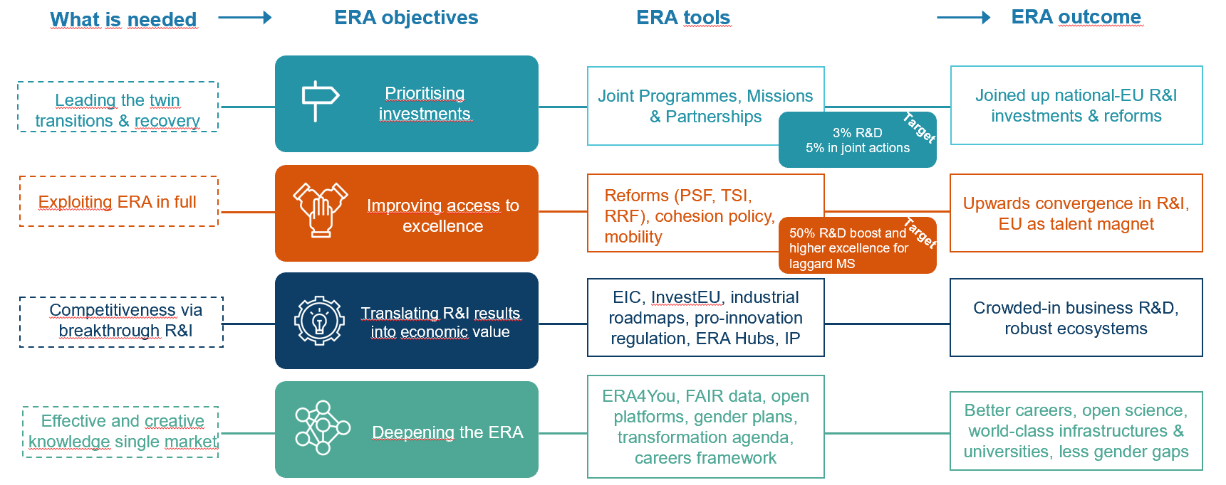
ERA leads to a comprehensive agenda
Source: Eur. Commission

Slide 17
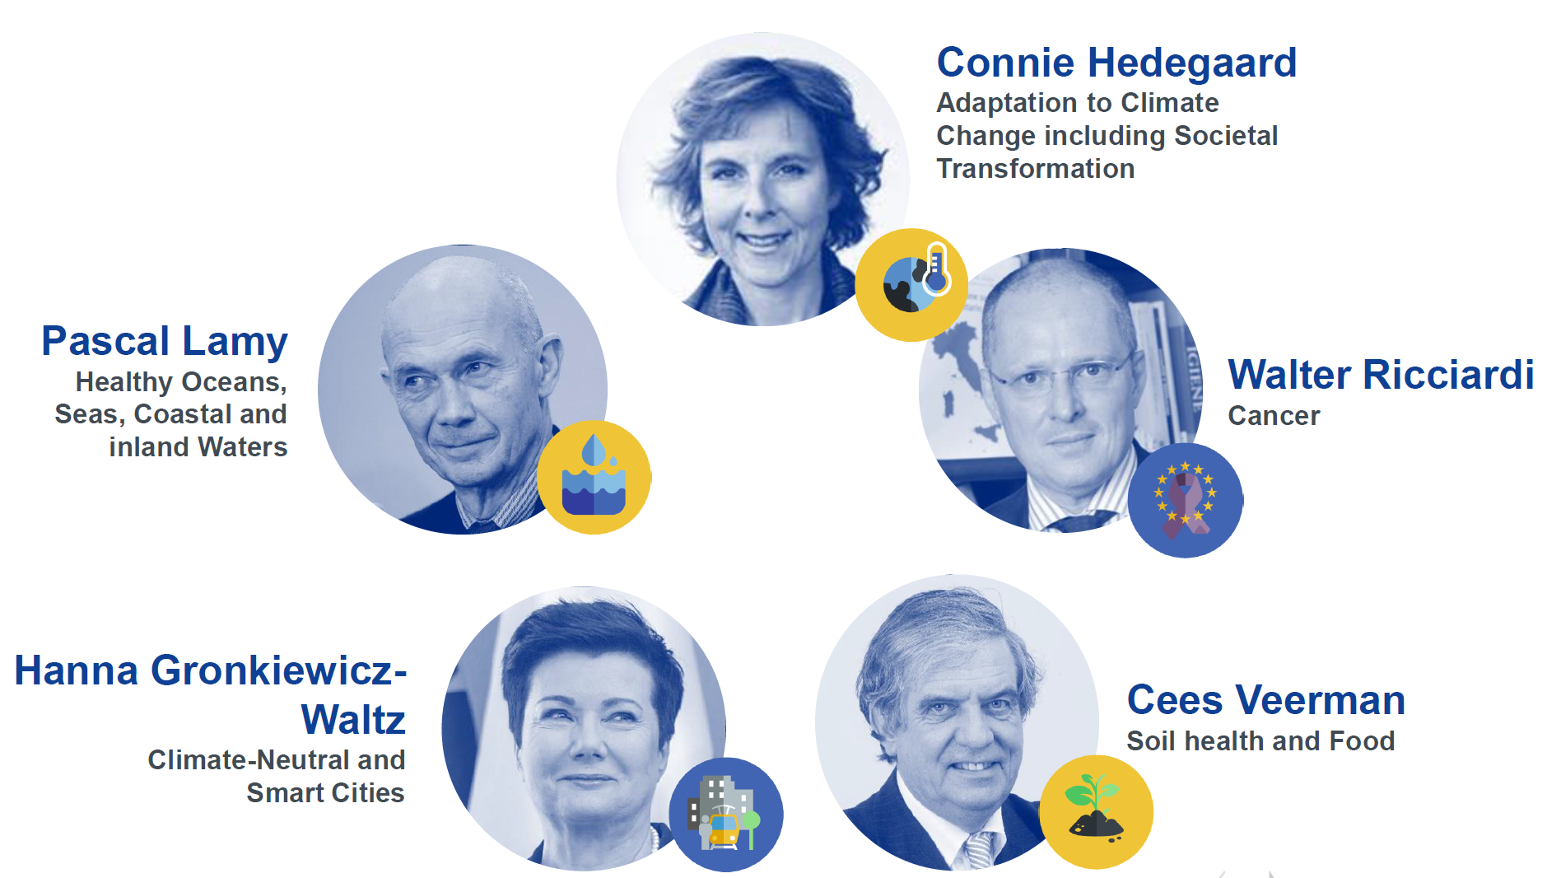
Missions
an entirely new approach based on portfolios of actions working towards broadly defined goals
Strong visibility and impact
Achieve a bold, inspirational and measurable goal within a set timeframe
Find solutions to some of the major challenges faced by European citizens
Implementation: to open up additional funds from other EU-sources
Expected: mid 2021

Slide 18
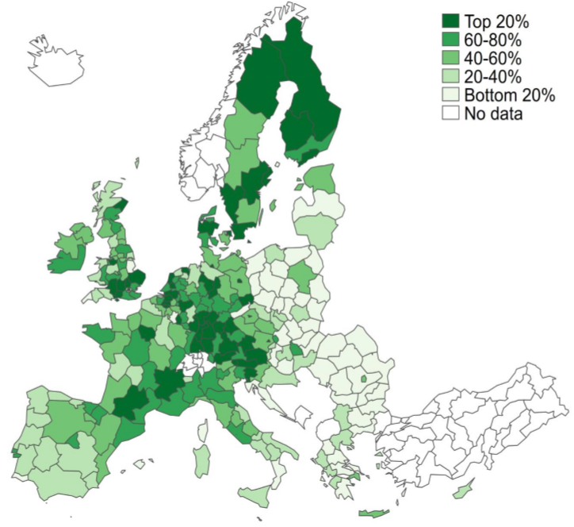
Need for reforms and improving excellence
WHY
R&D investment and performance amongst and within MS remains uneven
Support MS in maximising the quantity, quality and impact of R&I investments
policy dialogue and targeted technical assistance
Identify and implement the necessary reforms of R&I system
Member States below EU average R&D intensity increase their total investment by 50% in next 5 years
HOW
Total intramural R&D expenditure in PPS per inhabitant, average 2000-2016.
TARGET
“The research and innovation divide in the EU and its economic consequences”, Commission, May 2020

Slide 19
Erasmus University
Cooperation EUR in Horizon 2020
Notes:
#25 of

Slide 20
Erasmus University
Distribution of cooperation funding
Notes:
#25 of

Slide 21
Erasmus University
Distribution of cooperation funding
Brexit
Notes:
#25 of

Slide 22
Widespread - Twinning / Research Infrastructures
EUFORPP - Developing a European Forum on Paradox and Pluralism
EURHISFIRM - Historical high-quality company-level data for Europe

Slide 23
Nourishing talent for excellence and innovation ecosystems
A
European Framework for Research Careers:
comparable and interoperable research careers; taxonomy of researchers competences
enabling monitoring trends (labour market, careers, skills, talents circulation)
alleviating precarious working and employment conditions (incl. RESAVER)
Revamped Charter & Code and accompanying ERA Talent Platform
ERA4You initiative:
mobility schemes between industry and academia (new and existing)
targeted mobility measures attracting talents to Widening countries
Empowering universities and surrounding ecosystems, as part of key synergy initiatives between EEA and ERA
Transformation agenda empowering universities in modernisation towards the future, covering education, research, innovation and service to society missions
Investment strategy to deliver on the transformation agenda, in synergy with other EU and national funding programmes.

Slide 24
Contact
Jurgen Rienks rienks@neth-er.eu
Website www.neth-er.eu
Twitter @NetherBXL
@JurgenRienks

